Slide 1
Wholesale Distributor Data
DATS 6101-10 | Final Project
December 11, 2017
Alexa Giftopoulos
Monica Sharma
Rahul Sethi
Amanraj Singh

Slide 2
Background of Data
Source : UC Irvine Machine Learning Repository
Wholesale Client Data
Records :
440 Wholesale Clients
Fields (8) :
Channel (Nominal) – Channel number where the products are supplied
Region (Nominal) – Region number where the products are supplied
Fresh (Continuous) – Annual spending on fresh products
Milk (Continuous) – Annual spending on milk products
Grocery (Continuous) – Annual spending on grocery products
Frozen (Continuous) – Annual spending on frozen products
Detergents/Paper (Continuous) – Annual spending on detergents or paper products
Delicatessen (Continuous) – Annual spending on deli products

Slide 3
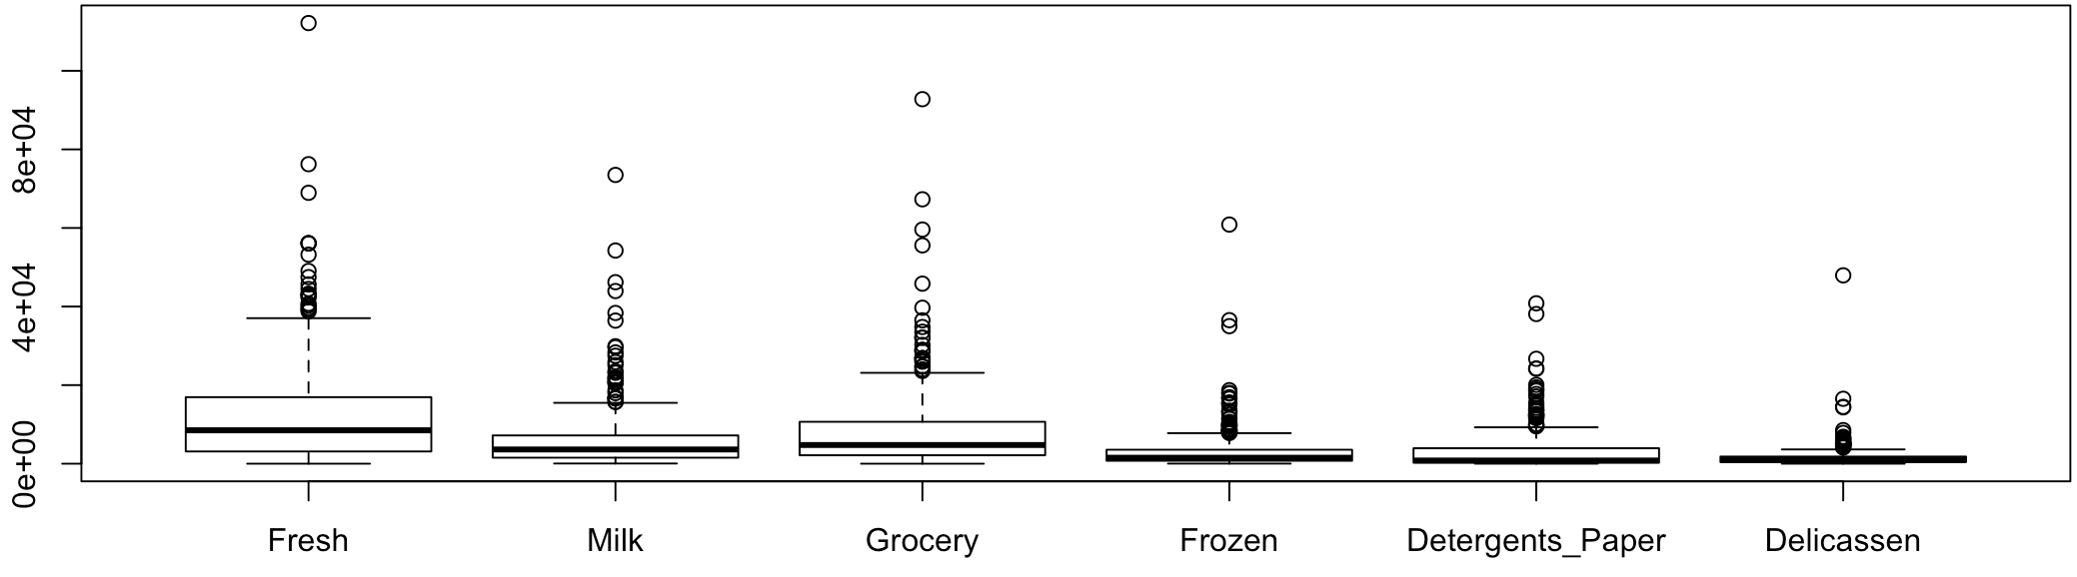
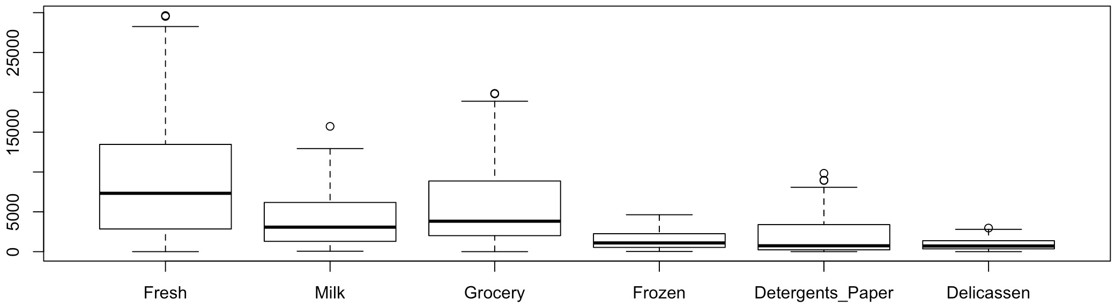
EDA – Remove Outliers & Standardize Data
Before:
After:
Notes:
We needed to standardize our data because there were large differences in the variance of each variable. Leaving these variances unequal would essentially put more weight on variables with smaller variances, so clusters would end up being separated along variables with greater variance.

Slide 4
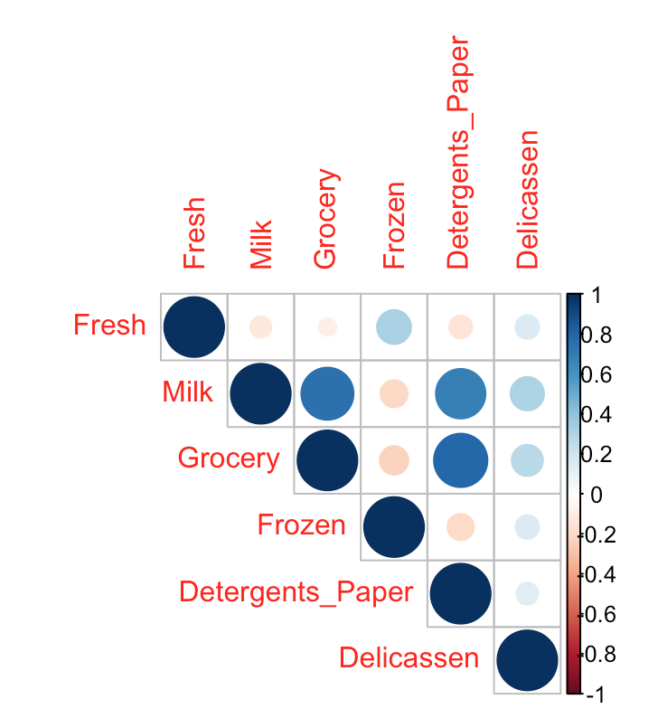
EDA - Correlation
Annual product purchases of clients:
Grocery and Detergents/Paper (.7964)
Milk and Grocery (.7597)
Milk and Detergents/Paper (.6859)

Slide 5
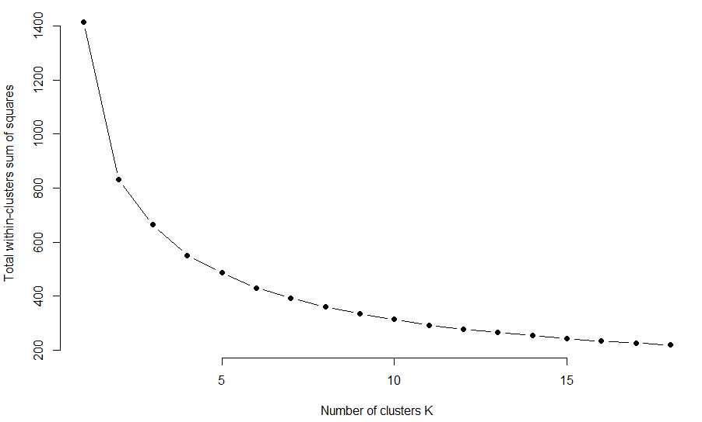
What type of establishments does our client list entail?
Methodology: K means clustering algorithm
Specify k (Elbow Method)
Evaluate k cluster centers
Assign values to nearest k cluster

Slide 6
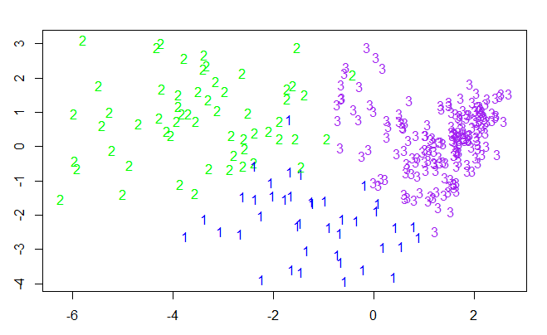
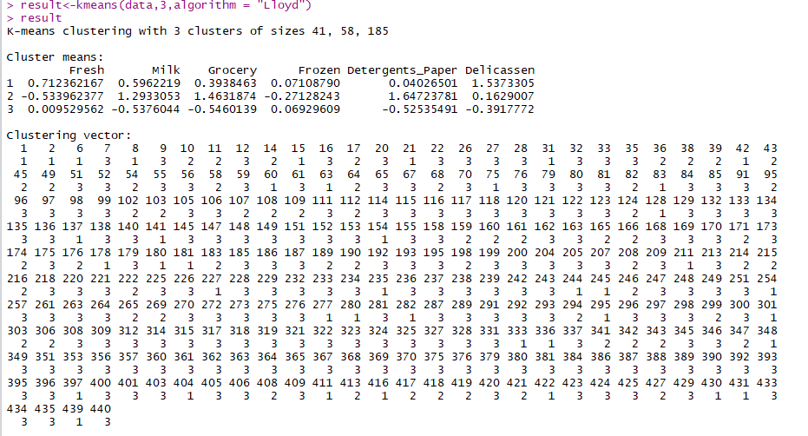
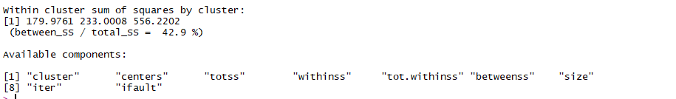
K means Clustering

Slide 7
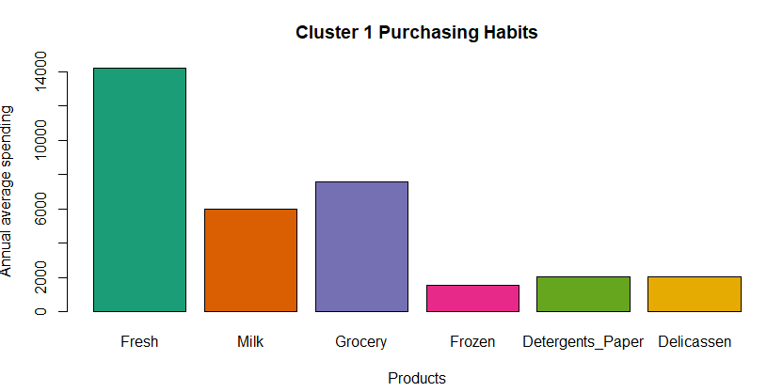
Cluster 1 Purchasing Preferences
Most spending on Fresh, Grocery, and Milk
Little spending on Deli, Detergents, and Frozen
Overall high average spending on products (33,000)
Represents larger establishments- large restaurant chain

Slide 8
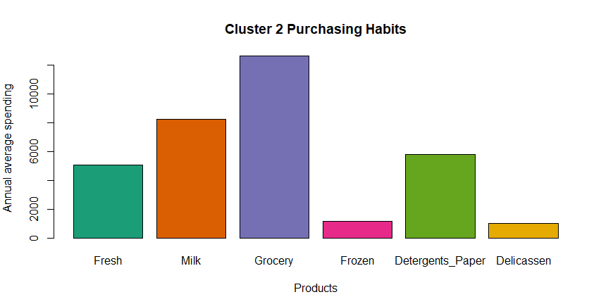
Cluster 2 Purchasing Preferences
Most spending on Grocery, Milk, and Detergents/Paper
Little spending on Frozen and Deli
Overall high average spending on products (32,000)
Represents supermarkets

Slide 9
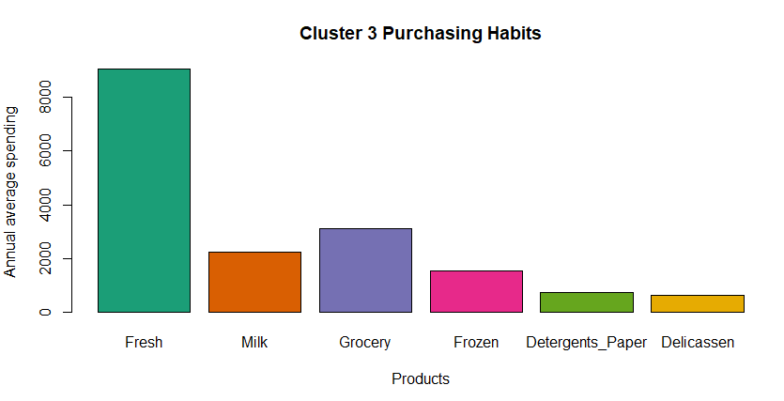
Cluster 3 Purchasing Preferences
Most spending on Fresh and Grocery
Little spending on Detergents and Deli
Overall low average spending on products (18,000)
Represents smaller fresh food establishments- Café’s, Local Diner’s

Slide 10
Conclusion
Manufacturer
Distributor
Wholesaler
Retailer
Seeks to:
Segment our wholesale clients based on product preferences
Purpose:
Maximize DC efficiency through reduced inventory, improved space, and assortment planning.
Increase revenue for our clients
→ Appropriate bundles and discounts based on consumer preferences
→ Decrease inventory costs
Client satisfaction and loyalty
Link to RPub - http://rpubs.com/amanrajs/340702

